Slide 1




Apple Retail Sales Analysis
Data Preprocessing & Data Analysis
Omar Essam & Mohamed Magdy
05/08/2025
1

Slide 2
Project Idea
Problem:
• Large dataset (250K+ rows) across 5 tables needs cleaning before analysis
• Raw data contains missing values, inconsistencies, and potential duplicates
• Need proper data structure to enable efficient SQL analysis
What Makes Our Project Stand Out:
• Comprehensive data preprocessing approach, not just analysis
• Focus on building a solid foundation for future insights
• Detailed documentation of every data cleaning step
Proposed Solution:
• Build robust data model with proper relationships between tables
• Clean and preprocess the dataset to ensure data integrity
• Prepare data for advanced SQL analysis and visualization
05/08/2025
2

Slide 3


Data Structure
Database Architecture:
• Relational database model with 5 interconnected tables
• Normalized structure to avoid data redundancy
Key Tables & Relationships:
• Stores: store_id, store_name, city, country
• Category: category_id, category_name
• Products: product_id, product_name, category_id, launch_date, price
• Sales: sale_id, sale_date, store_id, product_id, quantity
• Warranty: claim_id, claim_date, sale_id, repair_status
Data Relationships Visualization:
• Entity-Relationship Diagram (ERD) showing table connections
• Primary and foreign key relationships highlighted
05/08/2025
3

Slide 4
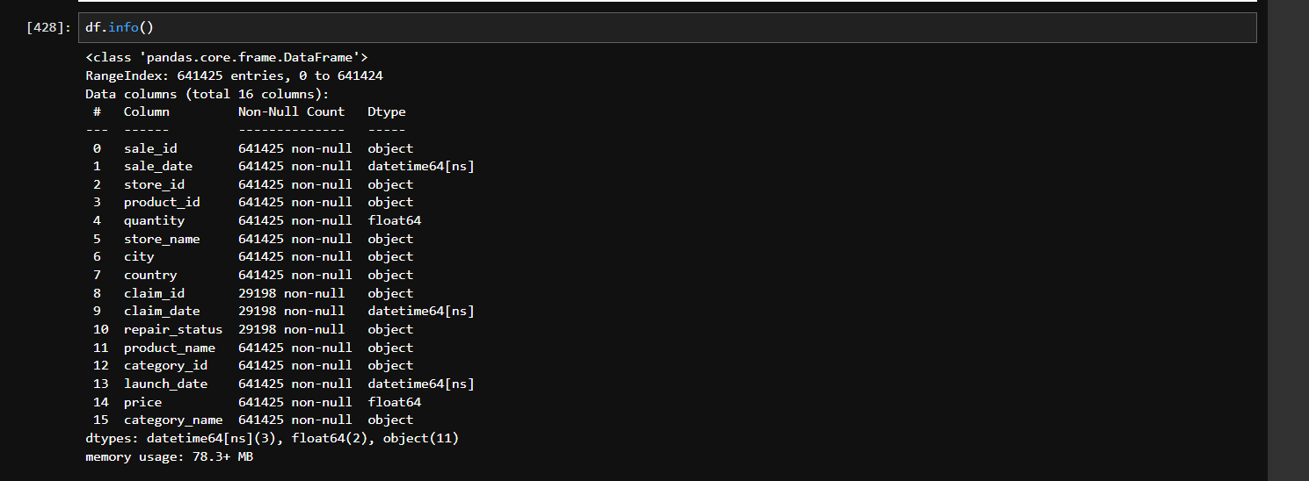
Data information
10/14/24
4

Slide 5
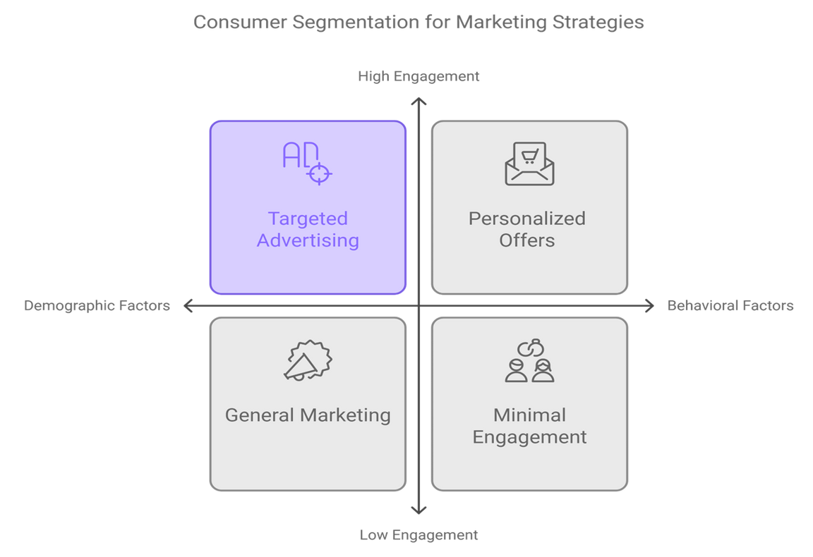
End Users & Features
Primary Users:
• Data Analysts: Need clean data for accurate SQL analysis
• Business Managers: Require reliable insights to make decisions
• Store Managers: Want to track store performance metrics
• Product Teams: Need to analyze product performance and warranty issues
05/08/2025
5

Slide 6
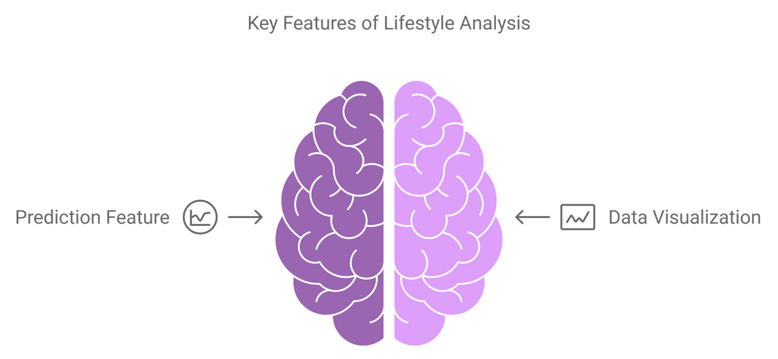
End Users & Features
Key Features of Our Solution:
• Consistent and clean dataset structure
• Well-documented data preprocessing methodology
• Optimized database design for efficient querying
• Foundation for reliable analytics dashboards
Benefits to Users:
• Analysts save time with prepared, clean data
• Managers gain confidence in data-driven decisions
• Product teams get accurate insights into performance and issues
05/08/2025
6

Slide 7
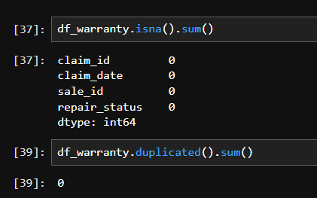
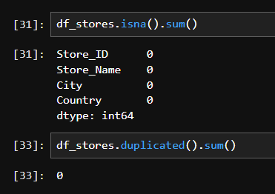
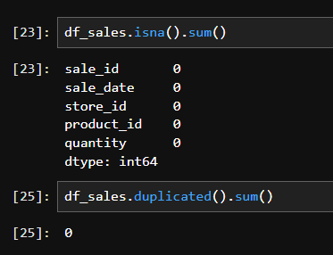
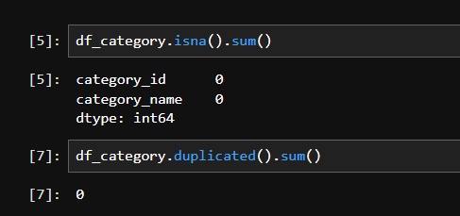
Preprocessing Workflow
Data Cleaning Process:
• Data Analysts: Need clean data for accurate SQL analysis
• Business Managers: Require reliable insights to make decisions
• Store Managers: Want to track store performance metrics
• Product Teams: Need to analyze product performance and warranty issues
05/08/2025
7

Slide 8
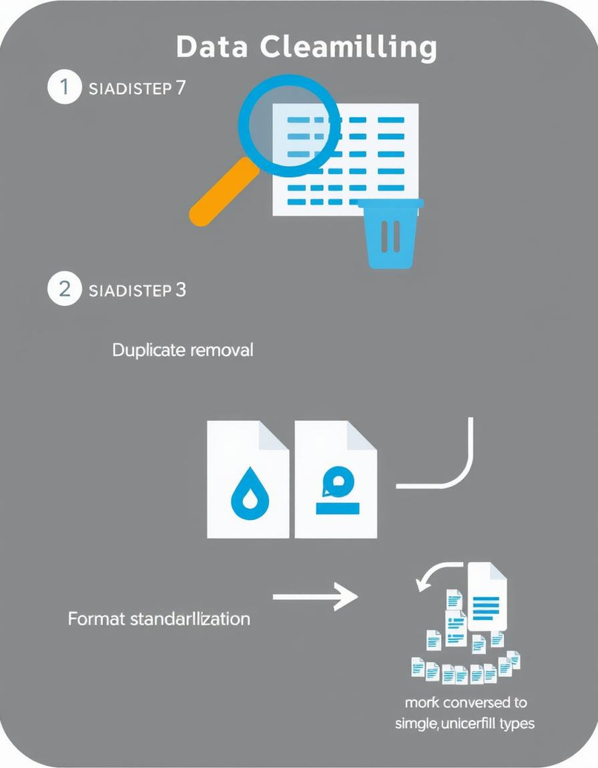
Preprocessing Workflow
Key Transformations:
• Date standardization across sales and warranty tables
• Currency normalization for price data
• Geographic data cleaning and enrichment
• Categorical data encoding and validation
Data Quality Checks:
• Completeness: Ensuring no critical data is missing
• Uniqueness: Verifying no problematic duplicates exist
• Consistency: Confirming relationships between tables are intact
05/08/2025
8

Slide 9
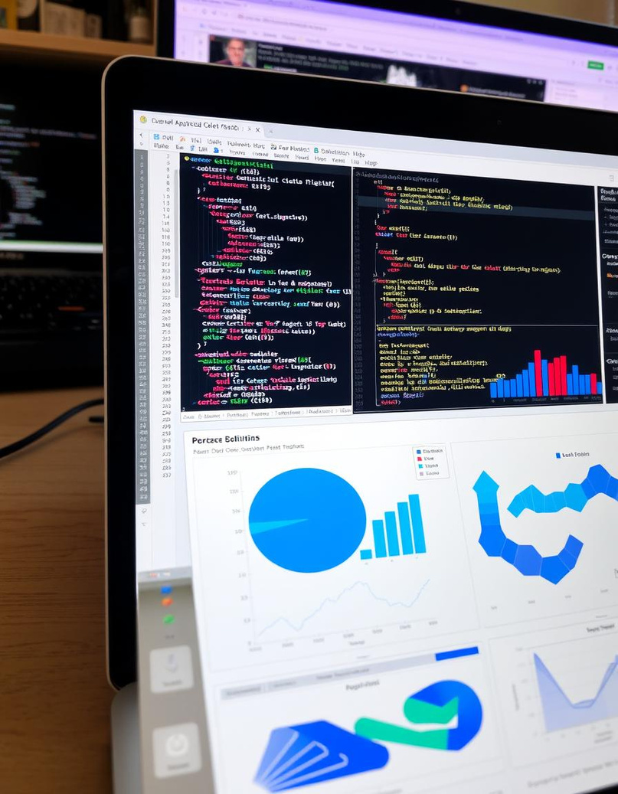
Technologies Used
Primary Tools:
• SQL: For data querying, joining, and transformation
• Python: For data preprocessing and exploratory analysis
• Power BI: For data visualization and Dashboard
Key Libraries & Frameworks:
• Pandas: Data manipulation and cleaning
• Matplotlib/Seaborn: Initial data visualization
• Jupyter Notebooks: Documentation of preprocessing steps
• SQLAlchemy: Python-SQL integration
05/08/2025
9

Slide 10
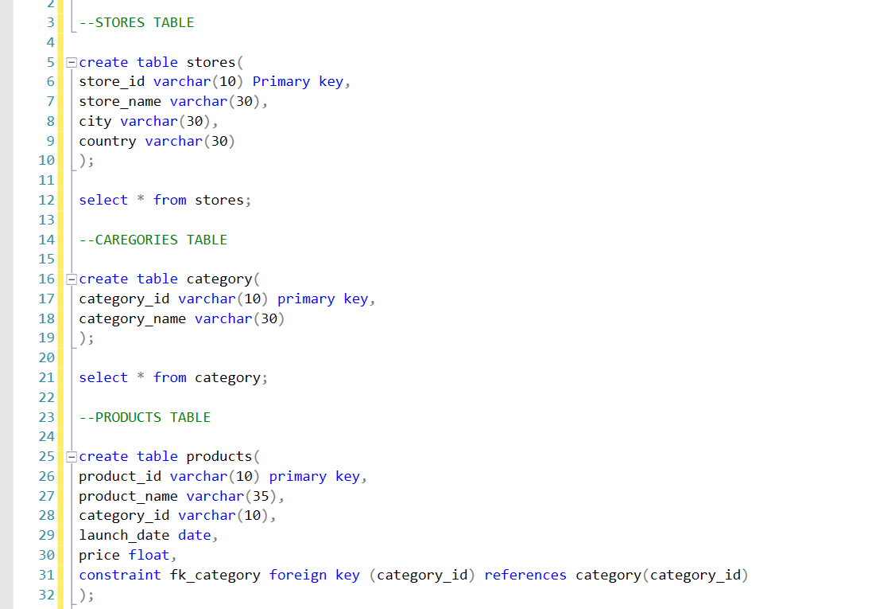
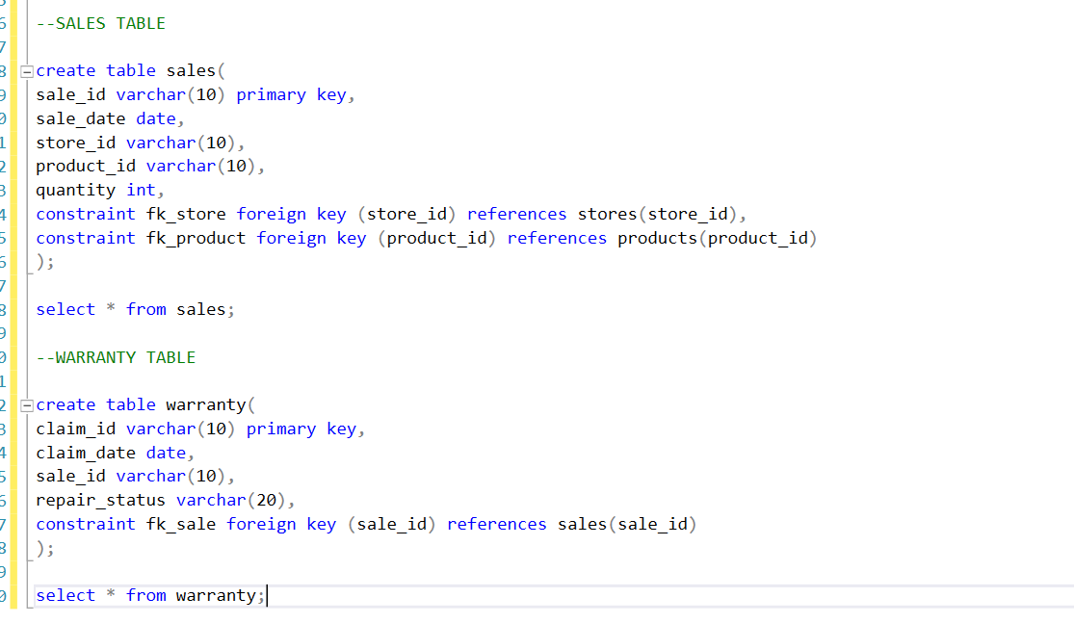
SQL - Table
05/08/2025
10

Slide 11
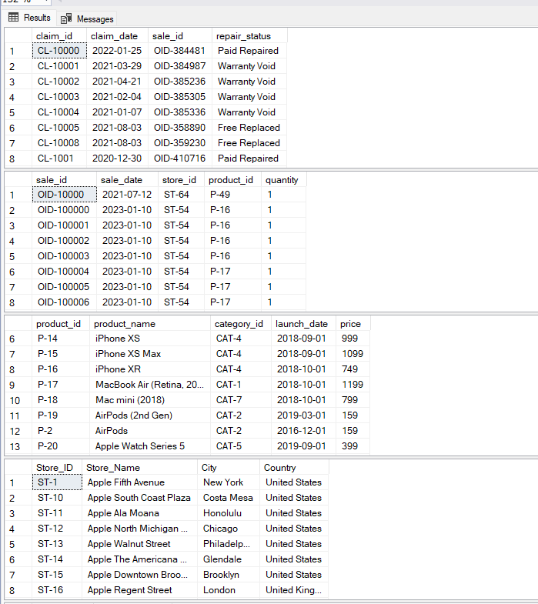
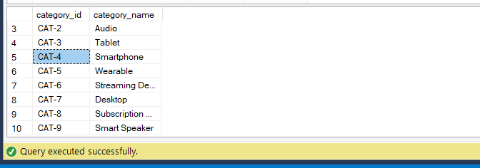
SQL - Table
05/08/2025
11

Slide 12
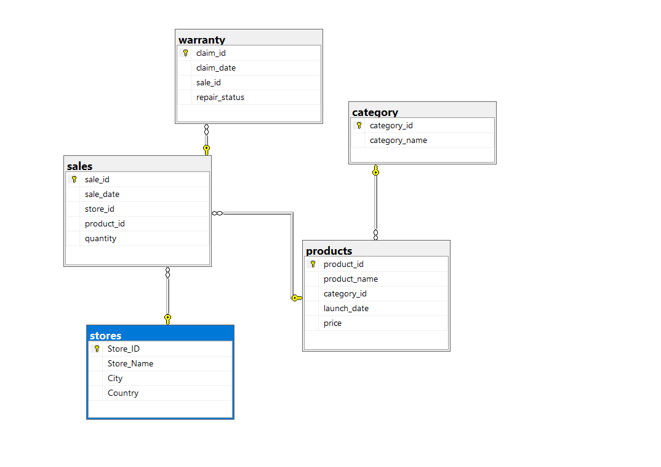
SQL - ERD
05/08/2025
12

Slide 13
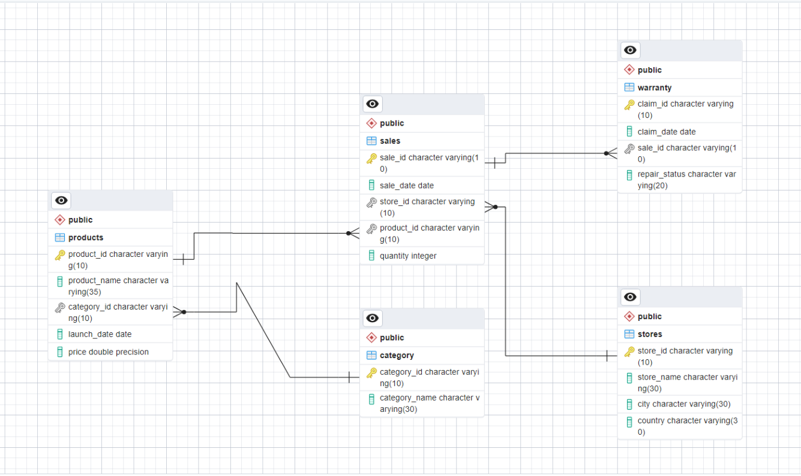
SQL - ERD
05/08/2025
13

Slide 14
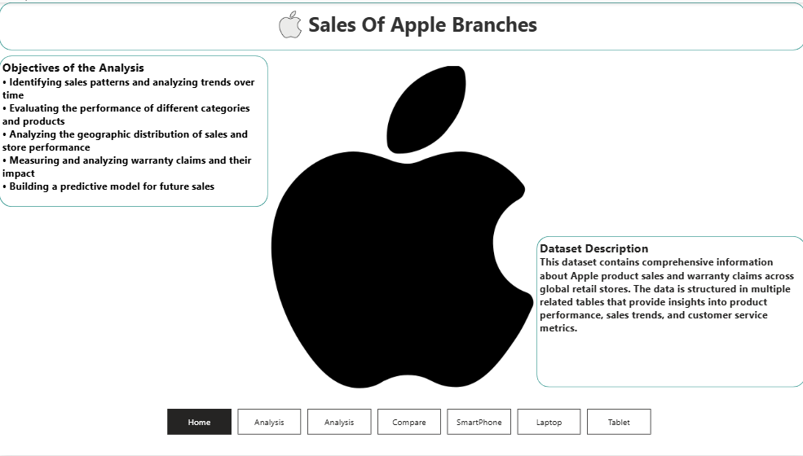
Data visualization (Power BI)
05/08/2025
14

Slide 15
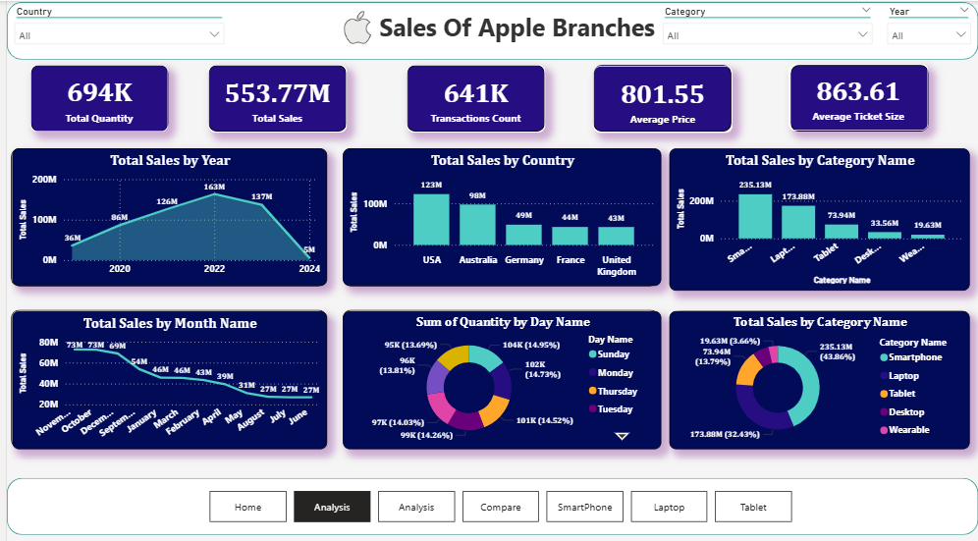
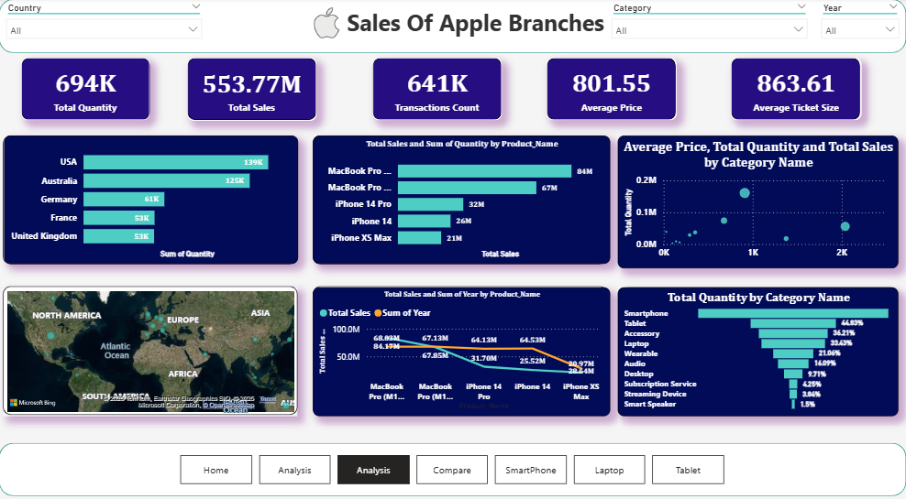
Data visualization (Power BI)
05/08/2025
15

Slide 16
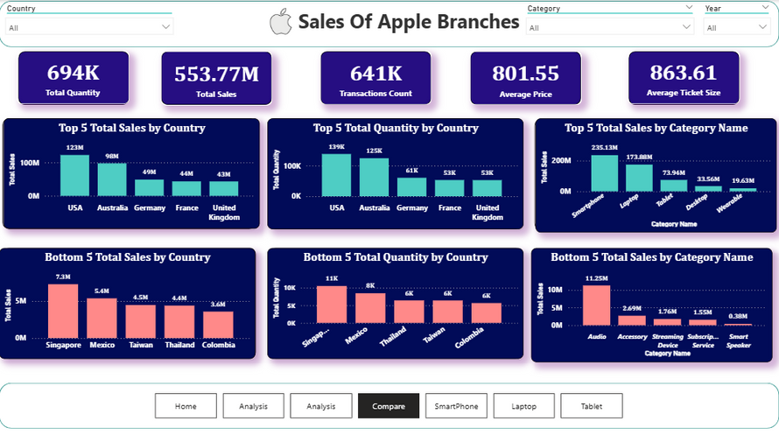
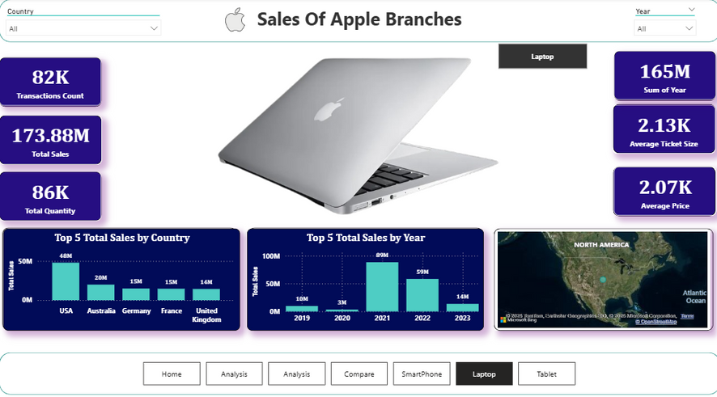
Data visualization (Power BI)
05/08/2025
16

Slide 17
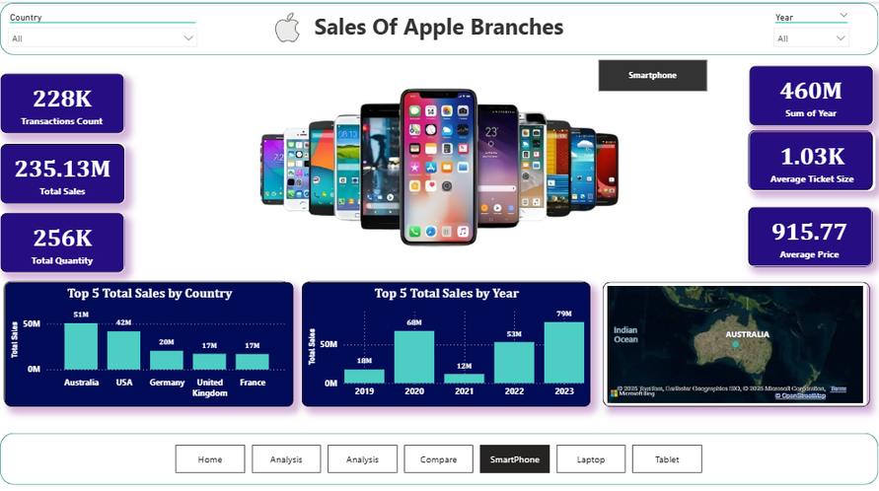
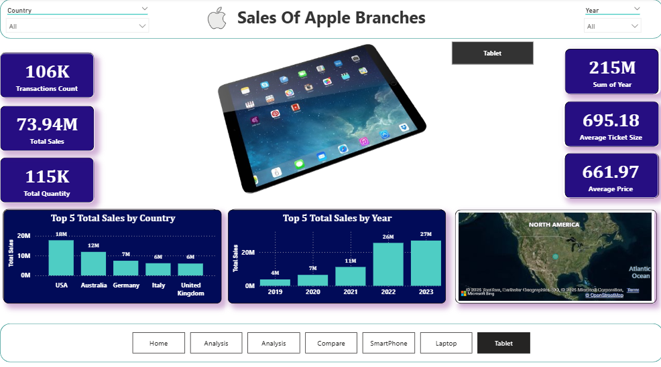
Data visualization (Power BI)
05/08/2025
17

Slide 18
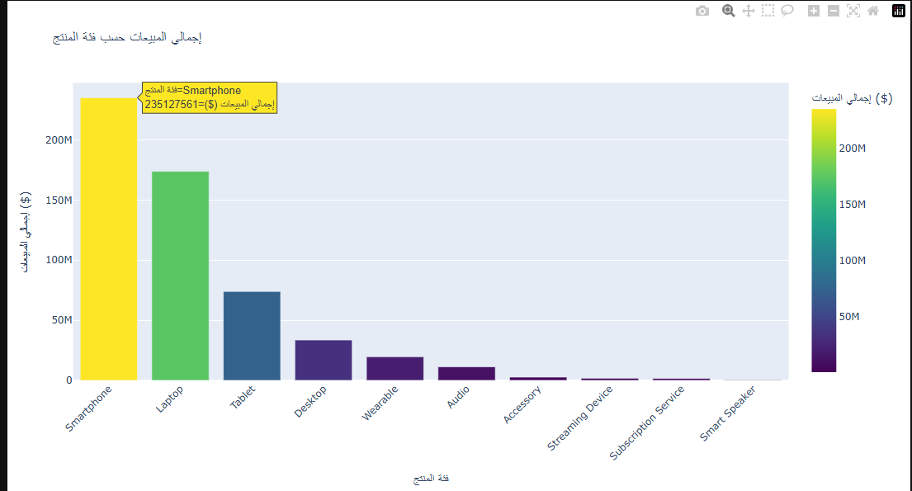
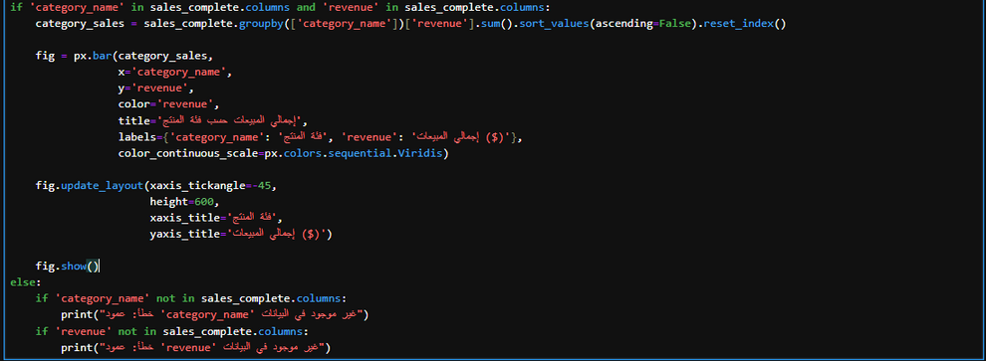
Data Preprocessing With Python
05/08/2025
18

Slide 19
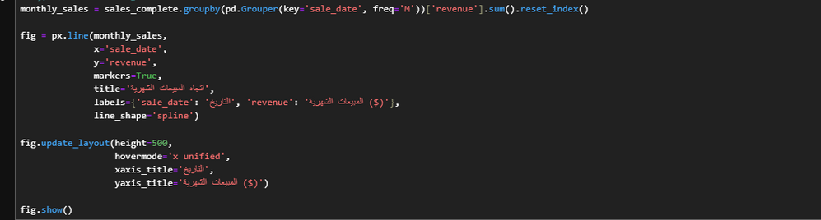
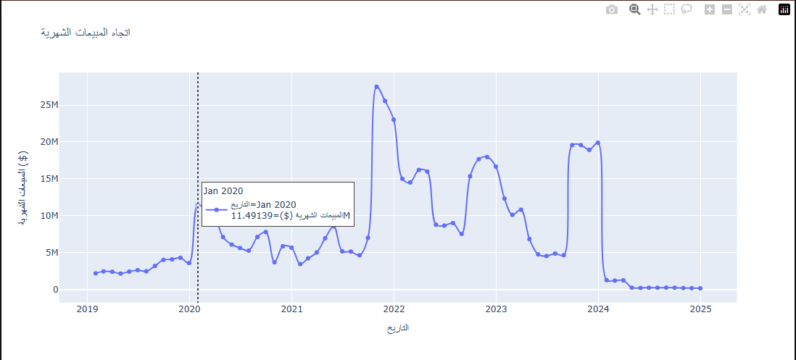
Data Preprocessing With Python
05/08/2025
19

Slide 20
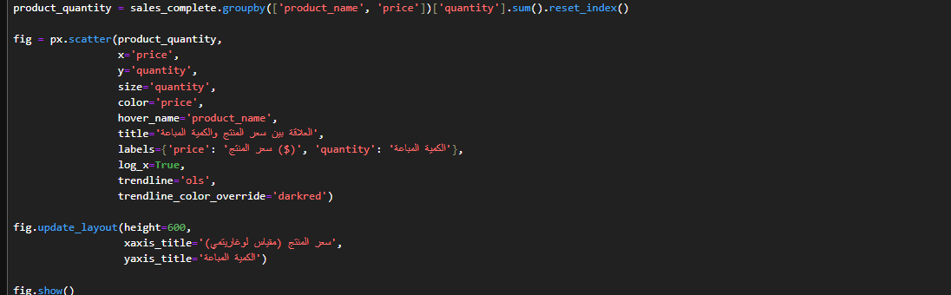
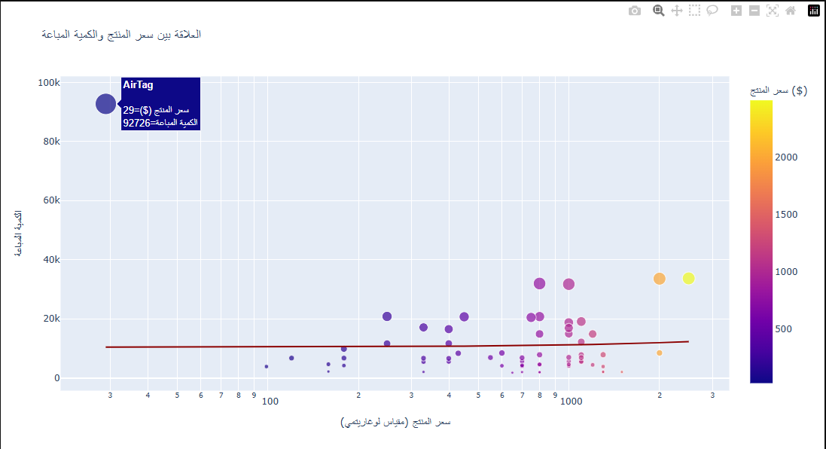
Data Preprocessing With Python
05/08/2025
20

Slide 21
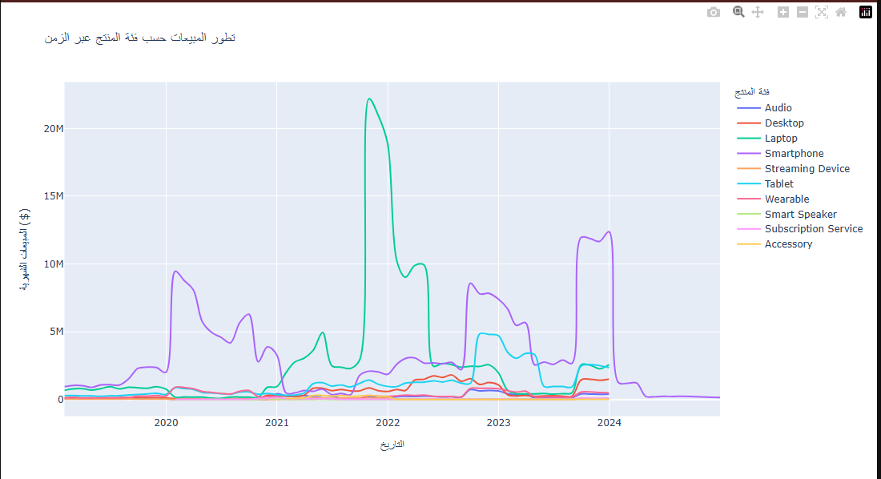
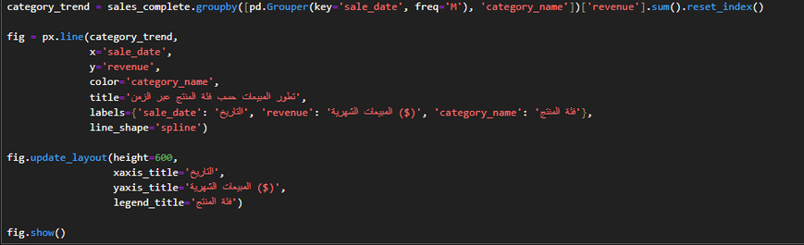
Data Preprocessing With Python
05/08/2025
21

Slide 22
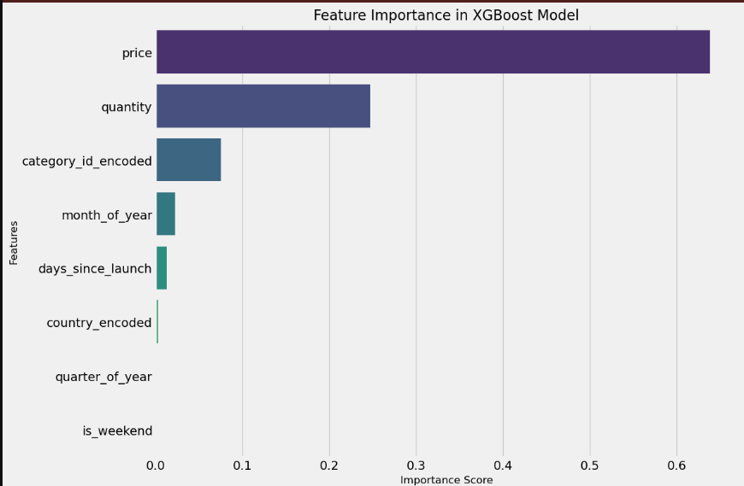
Simple Model
05/08/2025
22

Slide 23
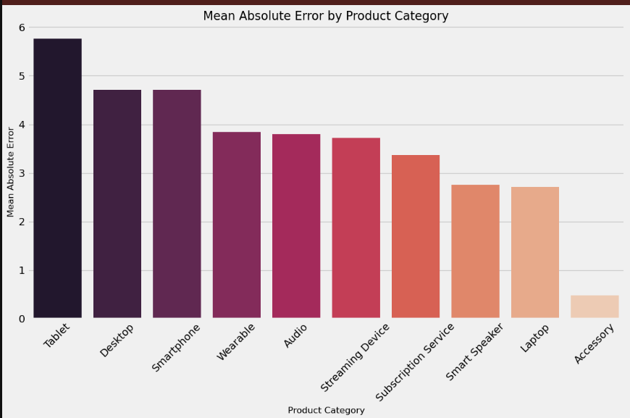
Simple Model
05/08/2025
23

Slide 24
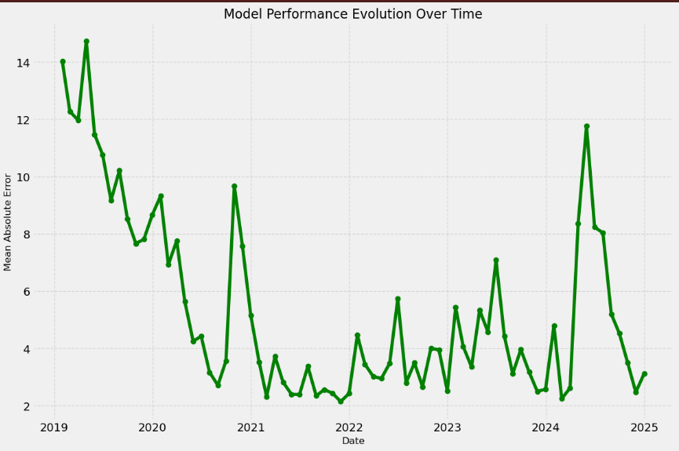
Simple Model
05/08/2025
24

Slide 25

Deliverables
Key Deliverables:
• Fully cleaned and preprocessed dataset
• Entity-Relationship Diagram (ERD) documentation
• Jupyter Notebook with detailed preprocessing steps
• Data quality report identifying and resolving issues
Processing Documentation:
• Data loading procedures
• Cleaning methodology
• Transformation techniques
• Validation checks
• SQL query optimization recommendations
05/08/2025
25

Slide 26
Thank You
For Any Further Information please contact:
Name:Omar Essam
NO:01123462415
Email: omarhendawey123@gmail.com
• Project Repository:https://github.com/3More1/Apple-Sales-Project
05/08/2025
26

